Slide 1
AliExpress Web App Redesign
Guided By
Dr. Abbas Moallem
Presented By: Musketeers
Mohit Shah
Prakruthi Suresh
Sheethal Halandur Nagaraja
Shreya Shah

Slide 2
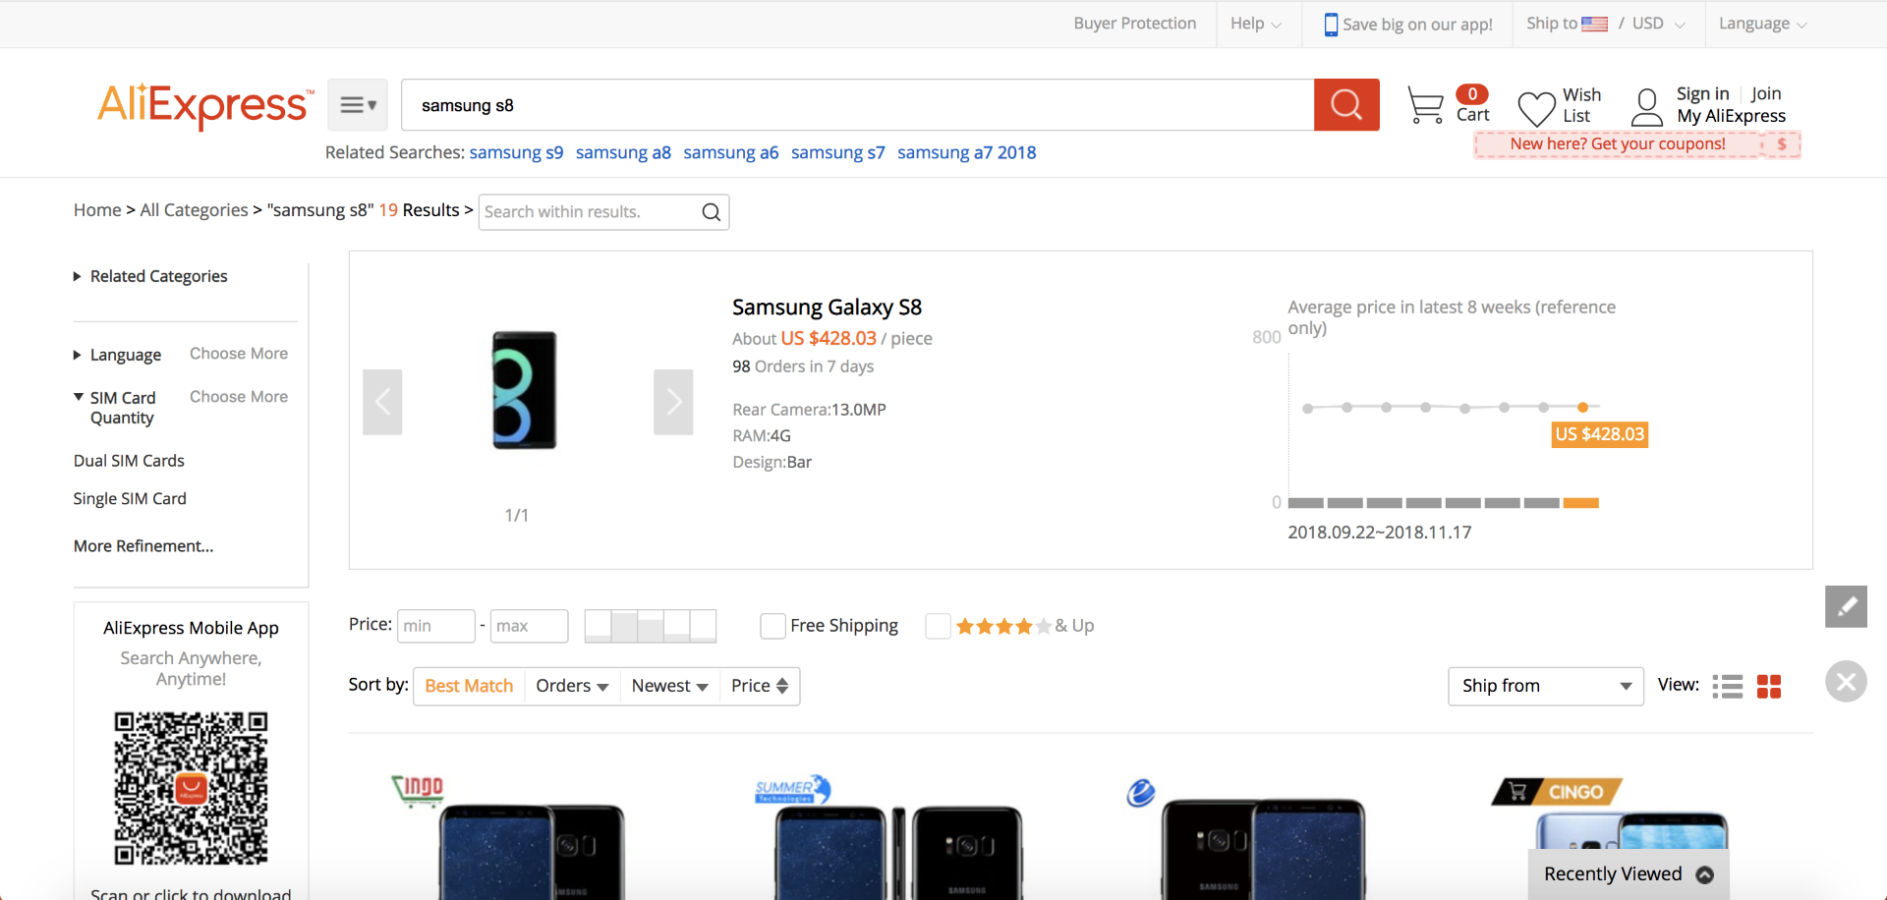
Filters
Filters are present both at the top of the page as well on the side bar
This is an example of bad grouping

Slide 3
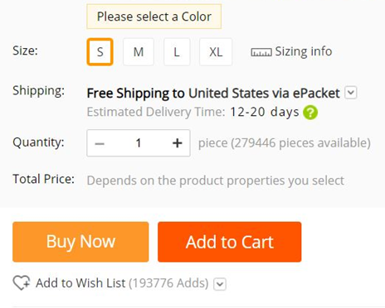
Feedback
Lack of discoverability of feedback message

Slide 4
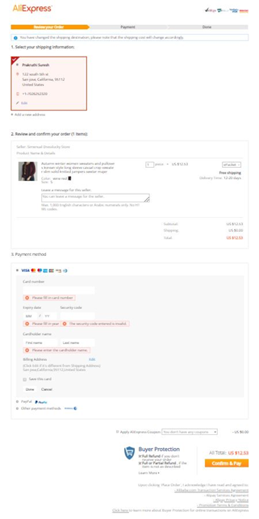
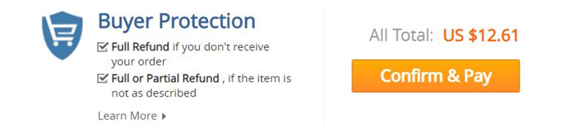
Mapping of mode
Mismatch between progress bar and information on page.

Slide 5
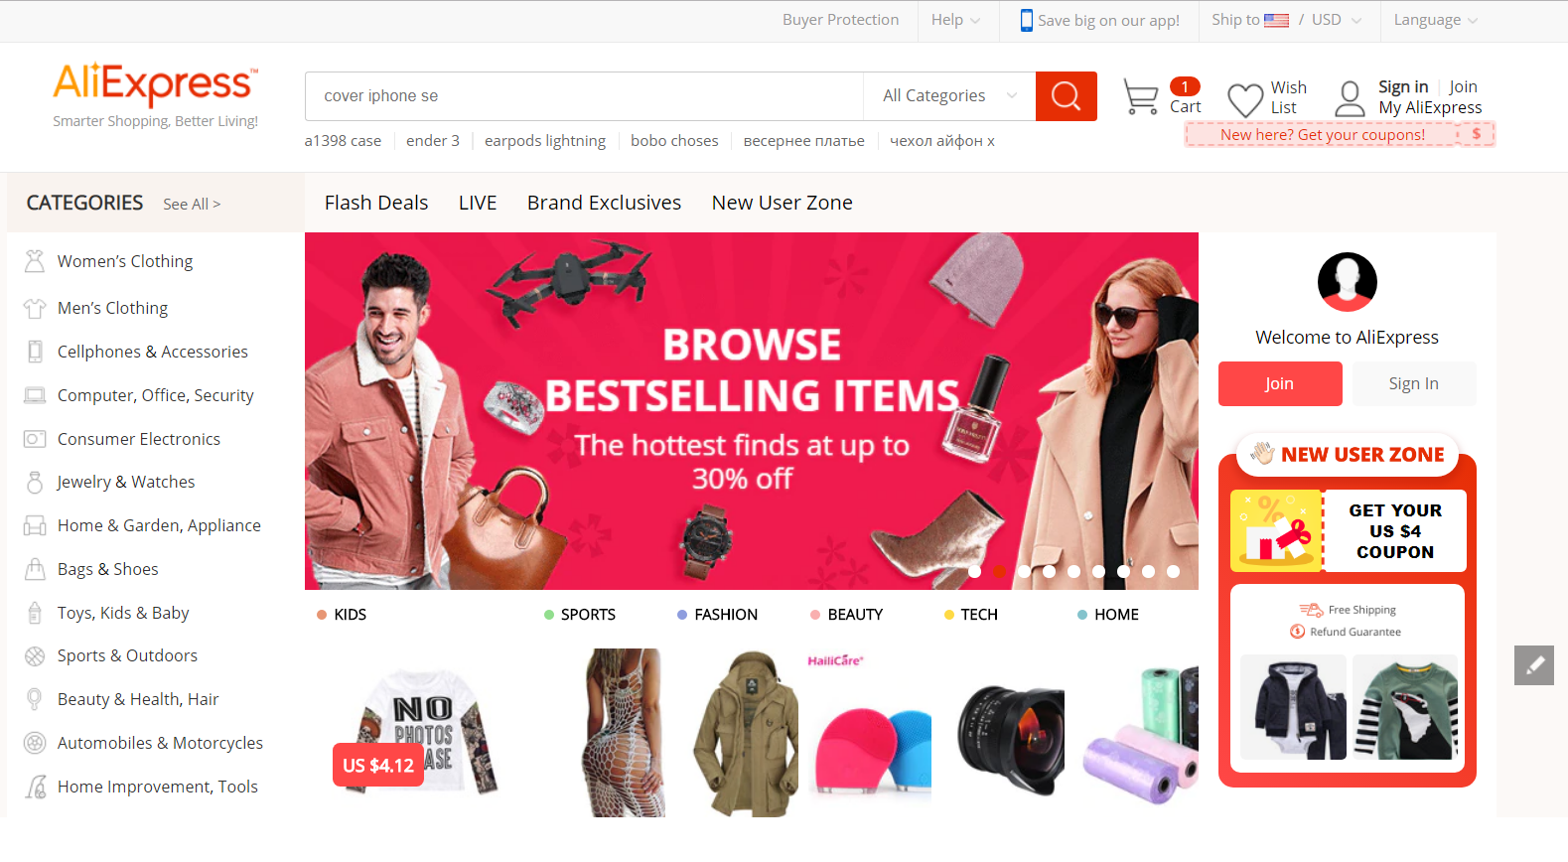
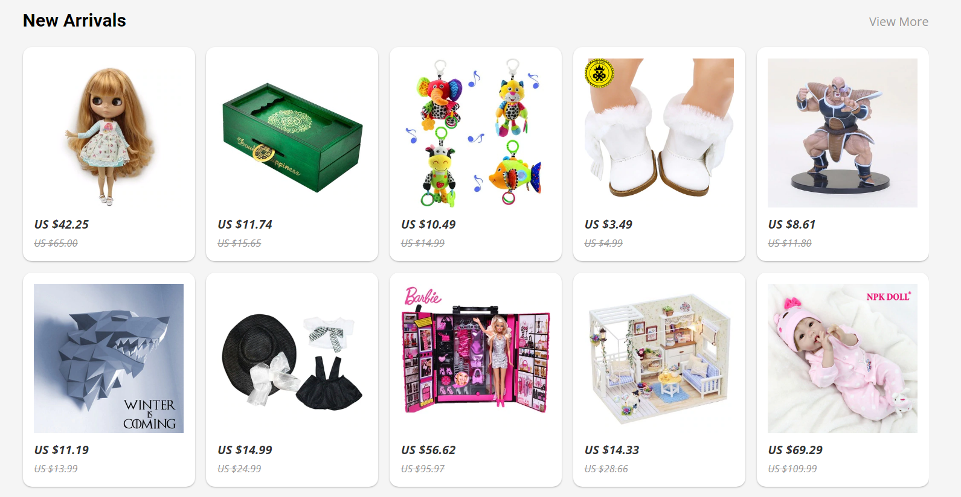
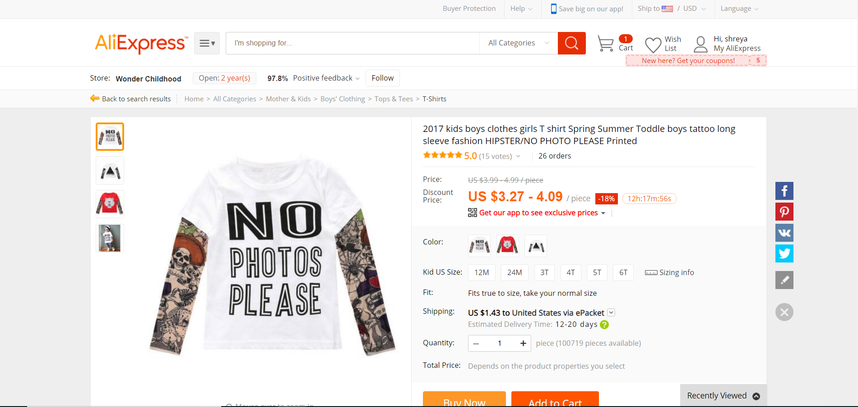
Lack of Transparency

Slide 6
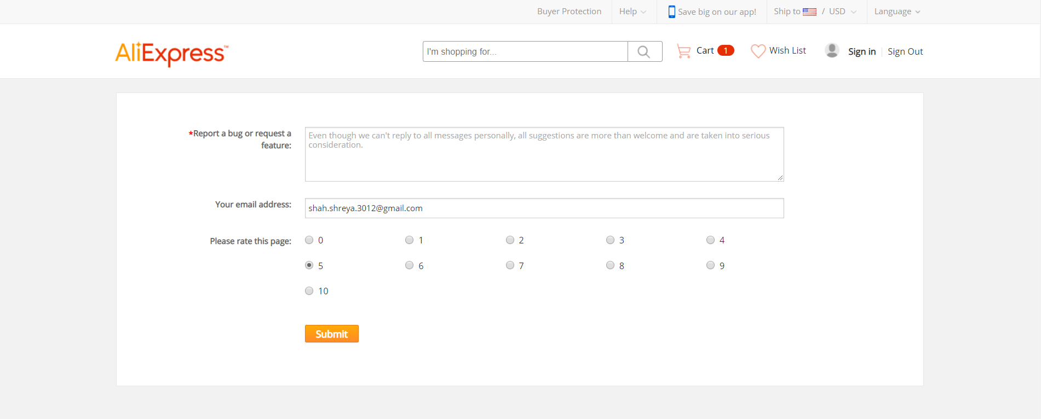
Top down Processing
Rating scale does not match with the users’ previous experiences.
Large labelling content reduces interest of the user’s on the screen

Slide 7
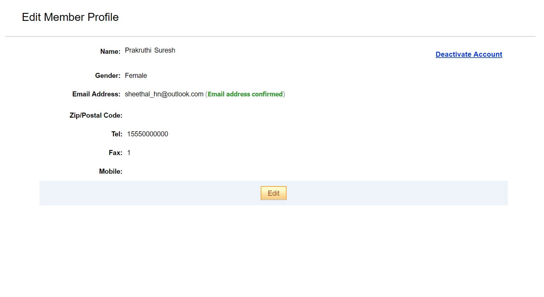
Lack of Consistency
Edit Member Profile opens up a new page which is not consistent with rest of the website.

